Slide 1
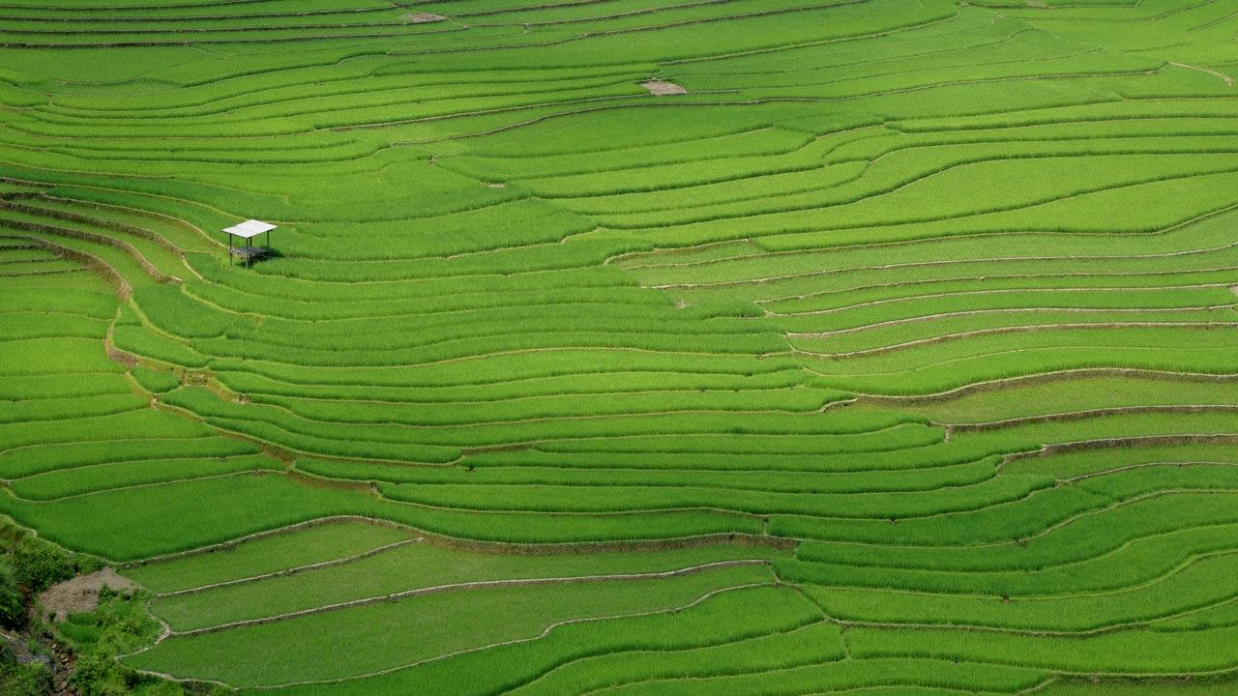
Kisaan
A Farm Monitoring System
Group 4

Slide 2
What is Kisaan?
A modern tool for the modern farmer.
Automatic and scheduled farm monitoring
Cost-effective temperature, humidity, air quality sensing
No more digging up entire fields after harvest season!
Farm data is just a few clicks away!

Slide 3

Why is Kisaan the future?

Slide 4
What does Kisaan cost?
A one-time installation of a strengthened aluminium frame.
Four motors and sensors
Electricity costs - with customizable frequency to save power.

Slide 5
The average Indian farm is a hectare in size.
Assuming farm dimensions as 100m x 100m, Kisaan requires a total of 400 metres of 20mm x 20mm aluminium profiles.
At the bulk market rate of Rs. 80/metre, the frame will cost Rs. 32,000.
Motors cost Rs. 8,000. The sensor bundle costs Rs. 1,200.
This all sums out to an initial cost of Rs. 42,000 approximately with an estimate of electricity costs at Rs. 8,000 per month.

Slide 6

Others in the Field
Related articles
https://www.engineering.com/DesignerEdge/DesignerEdgeArticles/ArticleID/16653/Smart-FarmingAutomated-and-Connected-Agriculture.aspx
https://www.realagriculture.com/2018/08/automation-is-changing-modern-farming/
https://www.digitaltrends.com/cool-tech/terrasentia-farm-robot/
Related Research
https://www.sciencedirect.com/science/article/pii/S1474667015349739

Slide 7
Why Kisaan is one of its kind

Slide 8
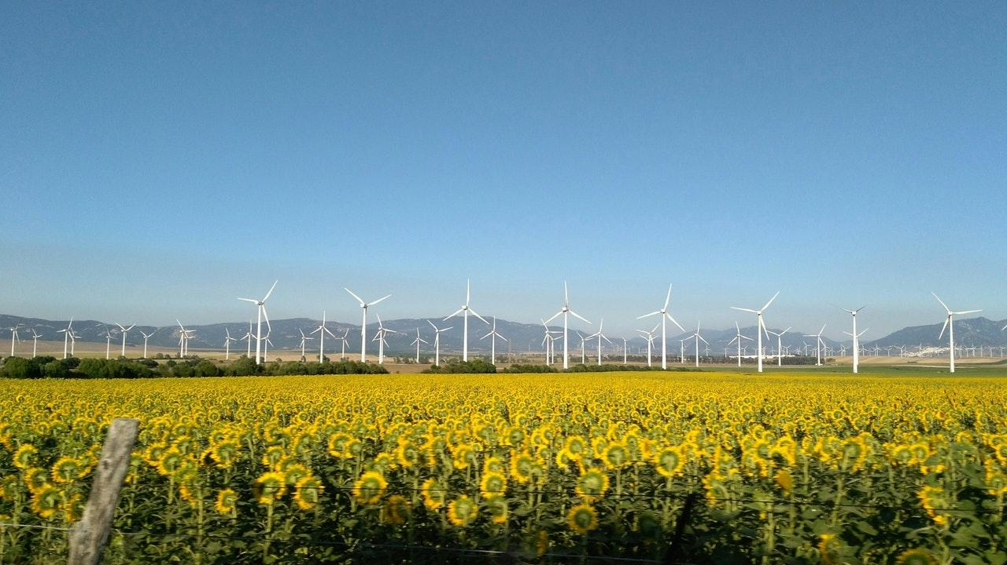
Cost Effective
In comparison to all existing technologies in the field, Kisaan makes itself accessible to the farmers, by fitting itself within the farmers’ budget and eliminating the use of other resources like labourers.

Slide 9

A Simple and Unique Structure
Uniqueness
Kisaan boasts of independent 3D motion supported by a simple frame structure.
Simplicity
Simple structure to ensures easy repair in case of any damage
Reliability
Farm logs stored remotely with regular updates!

Slide 10
Cost Effective
Kisaan just uses one set of sensors to monitor the entire farm, unlike existing technologies. Also, it creates a safe environment for the sensors by keeping them onboard!

Slide 11
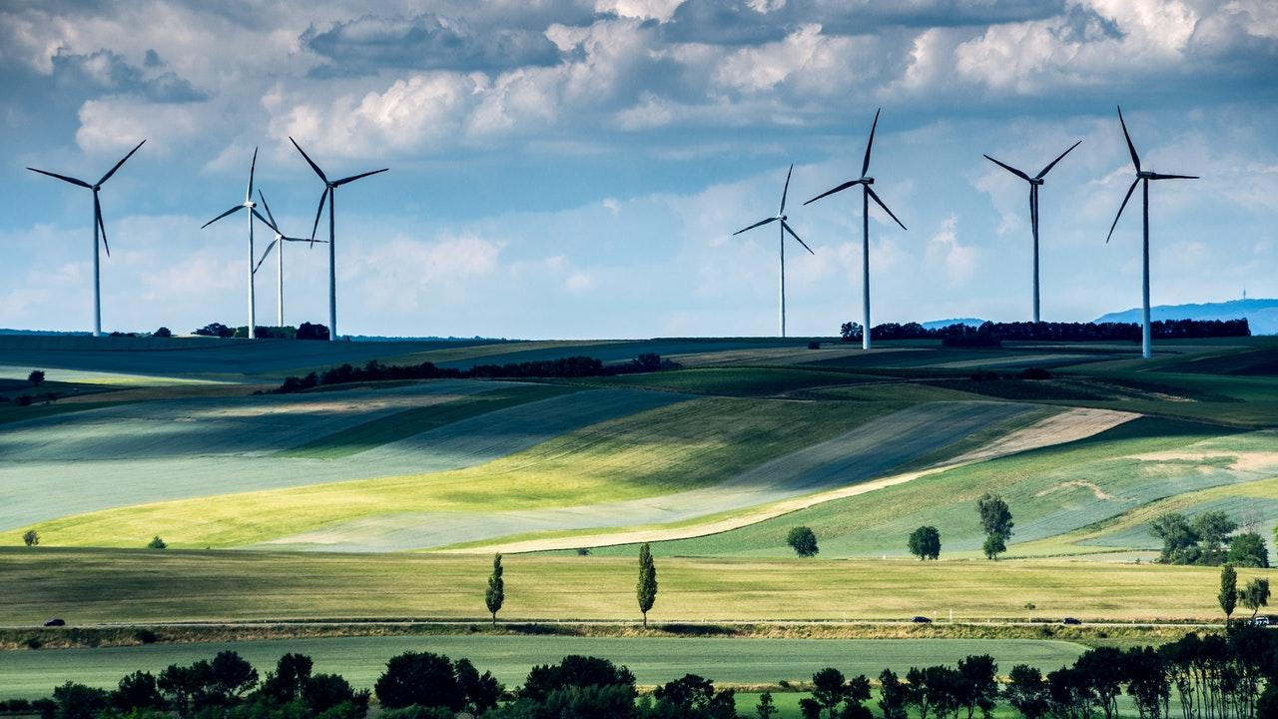
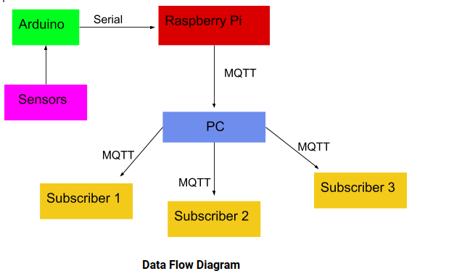

Slide 12

Use diagrams to

